Slide 1



Project-Stroke Prediction
Professor: Sujoy Paul
Team:
Yoginder Singh
Rohan Pradeep
Guarding Health, Predicting Strokes?

Slide 2
About the Project
We have chosen this dataset as it focuses on predicting the likelihood of a patient experiencing a stroke. Stroke, recognized by the World Health Organization (WHO) as the second leading cause of death globally, accounts for approximately 11% of total deaths. This dataset will help to analyze key input parameters such as gender, age, the presence of various diseases, and smoking status to develop predictive models for identifying individuals who may be at risk of experiencing a stroke. Each row in the dataset contains pertinent information about a patient, enabling us to delve into the intricate relationships between these factors and the occurrence of strokes, ultimately contributing to a deeper understanding of stroke risk factors and preventive measures.

Slide 3

Essential Element for Data Set
Variable Information
id: unique identifier
gender: "Male", "Female" or "Other"
age: age of the patient
hypertension: 0 if the patient doesn't have hypertension, 1 if the patient has hypertension
heart_disease: 0 if the patient doesn't have any heart diseases, 1 if the patient has a heart disease
ever_married: "No" or "Yes"
work_type: "children", "Govt_jov", "Never_worked", "Private" or "Self-employed"
Residence_type: "Rural" or "Urban"
avg_glucose_level: average glucose level in blood
bmi: body mass index
smoking_status: "formerly smoked", "never smoked", "smokes" or "Unknown"*
stroke: 1 if the patient had a stroke or 0 if not *Note: "Unknown" in smoking_status means that the information is unavailable for this patient

Slide 4
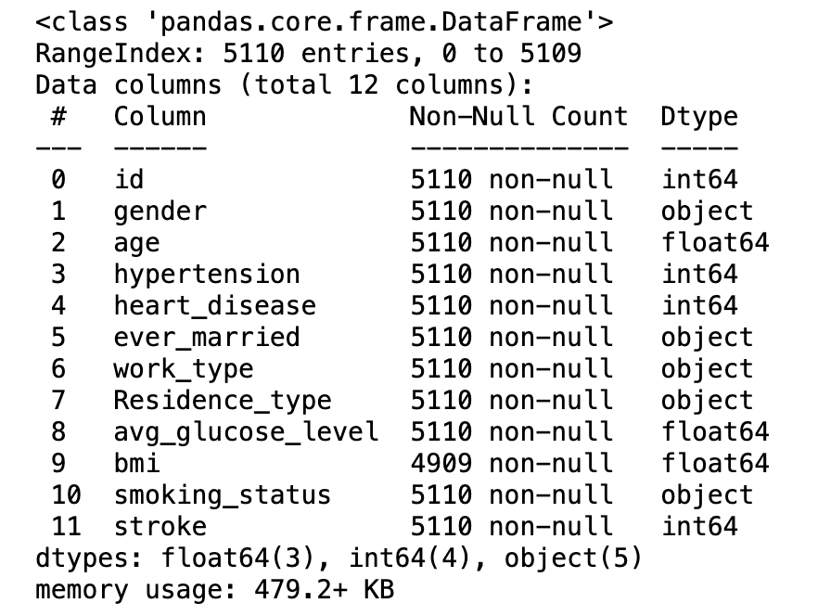
Data
Information
The provided DataFrame comprises 5110 entries with 12 columns, representing data related to stroke occurrences. Key features include demographic information such as gender, age, and marital status, along with health-related factors like hypertension, heart disease, average glucose level, and BMI. The dataset also includes lifestyle attributes such as work type, residence type, and smoking status. Notably, the 'bmi' column has some missing values. The 'stroke' column is a binary indicator for stroke occurrence. The DataFrame offers a comprehensive overview of various factors that may be analyzed to understand patterns and risk factors associated with strokes in the given population.

Slide 5
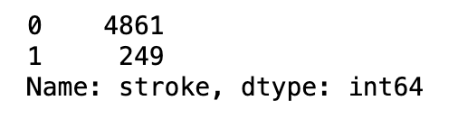
Data Processing
Balancing of Data.(Output Variable)
Class imbalance in a dataset refers to a situation where the distribution of labels is not roughly equal. This imbalance can have important implications, especially in the context of machine learning classification tasks.
The analysis of the 'Stroke' column in the dataset reveals a substantial class imbalance, with 4861 instances marked as 0 (indicating no stroke) and only 249 instances marked as 1 (indicating stroke).
This imbalance poses a potential challenge for machine learning models, as they may become biased towards predicting the majority class. To address this issue and ensure a more robust model, it would be advisable to explore techniques such as oversampling the minority class or under sampling the majority class to achieve a better balance in the dataset.

Slide 6
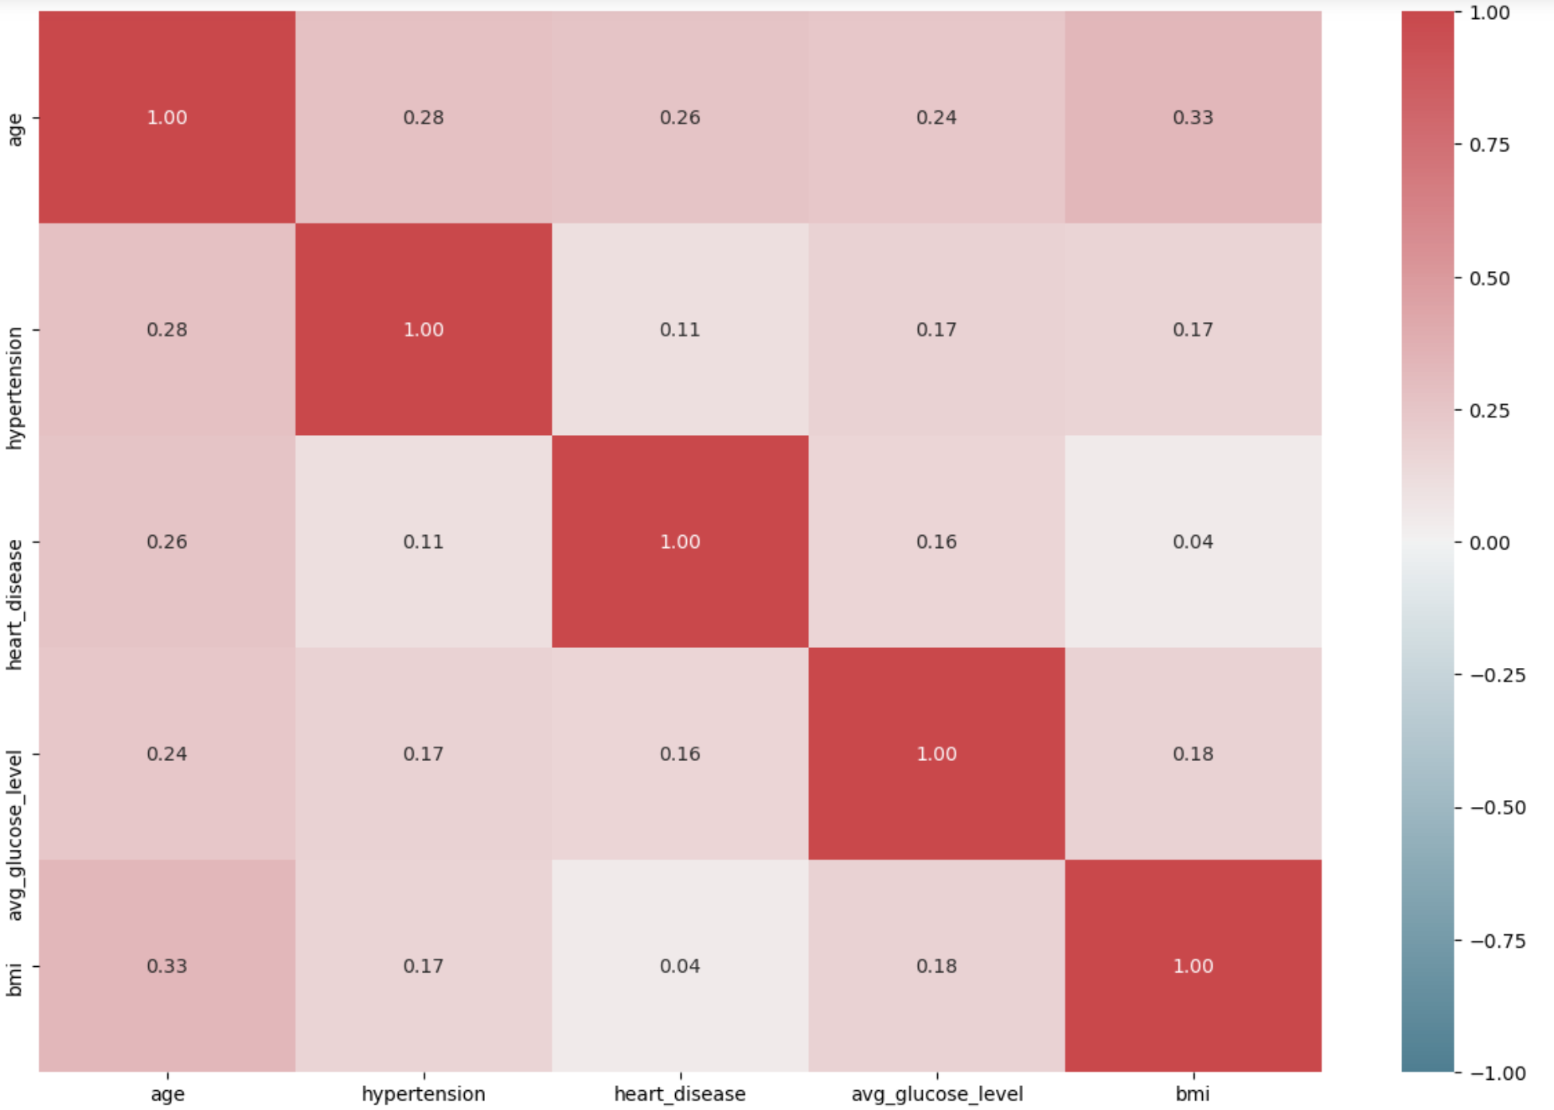
Data Processing
Checking multicollinearity
The predictors demonstrate a favorable characteristic of minimal correlation among themselves, indicating low multicollinearity. This lack of excessive interdependence between predictors is advantageous for the model, as it helps mitigate potential issues associated with multicollinearity. A lower degree of multicollinearity contributes to a more stable and reliable regression model, as each predictor can independently contribute valuable information without being overly influenced by the presence of highly correlated predictors.

Slide 7
Descriptive Statistics
Variable | Count | Mean | Std Dev | Min | 25th % | Median | 75th % | Max
Age | 5110 | 43.23 | 22.61 | 0.08 | 25.00 | 45.00 | 61.00 | 82.00
Hypertension | 5110 | 0.097 | 0.297 | 0.00 | 0.000 | 0.000 | 0.00 | 1.00
Heart Disease | 5110 | 0.054 | 0.226 | 0.00 | 0.000 | 0.000 | 0.00 | 1.00
Avg Glucose Level | 5110 | 106.15 | 45.28 | 55.12 | 77.245 | 91.885 | 114.09 | 271.74
BMI | 4909 | 28.89 | 7.85 | 10.30 | 23.500 | 28.100 | 33.10 | 97.60
The table above displays key descriptive statistics for our health dataset, providing insights into the age, hypertension, heart disease prevalence, average glucose levels, and BMI of the studied population.

Slide 8
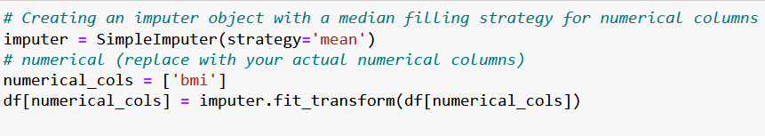
Missing Data
Effective Imputation of Missing Data in 'bmi' Column
Identified 201 missing values in the 'bmi' column, necessitating data imputation for accurate analysis.
Implemented mean imputation using SimpleImputer to maintain statistical integrity of the dataset.
Executed imputation effectively, ensuring no missing values remain in the 'bmi' column.
Confirmed successful data imputation with df.isnull().sum(), indicating zero missing values post-process.

Slide 9
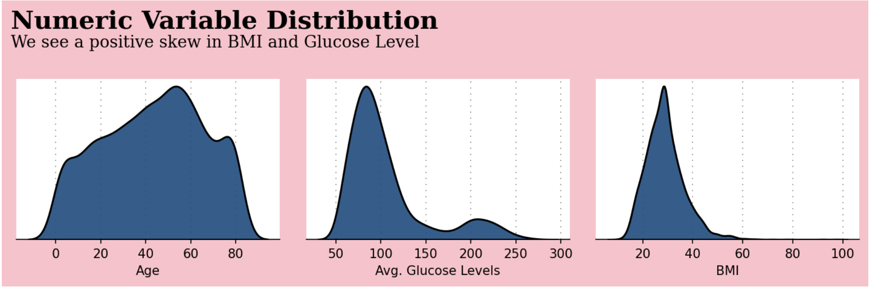
Data Exploration
Understanding the distribution of numeric variables is crucial for modeling and analyzing data effectively. It enables the selection of appropriate statistical methods, accurate prediction, and valid conclusions. The choice of a specific distribution depends on the data characteristics and analysis assumptions. In our case, the positively skewed distributions of BMI and glucose levels are represented in the graph, highlighting key insights into age, glucose, and BMI relationships

Slide 10
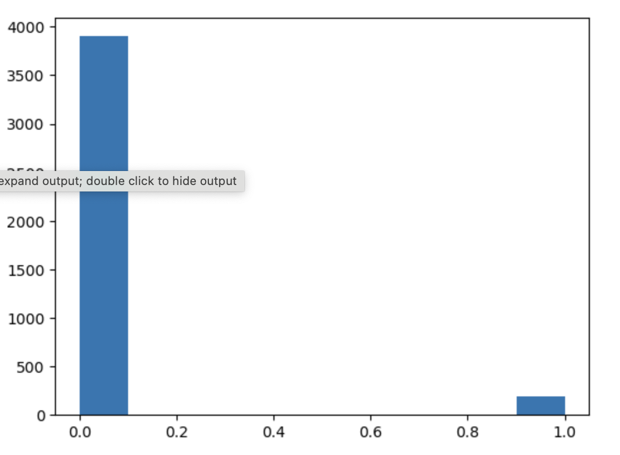
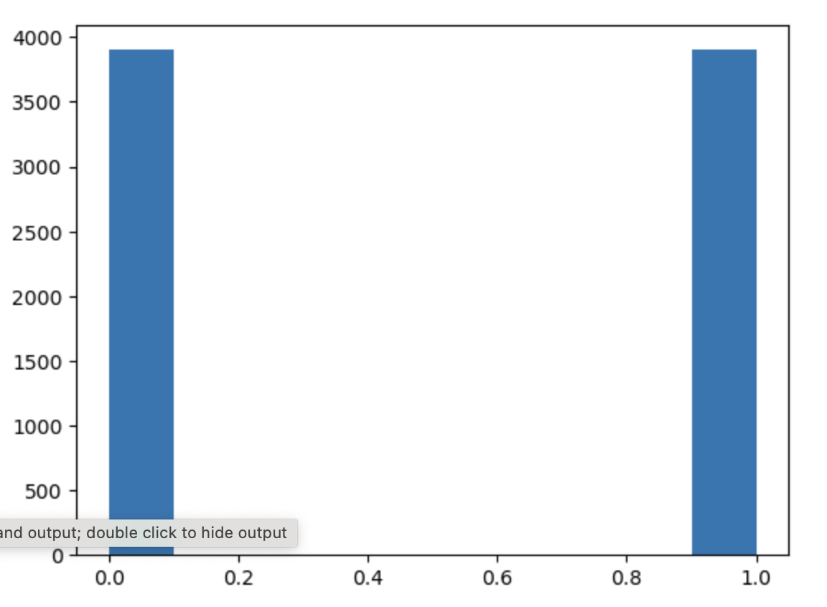
Applying SMOTE Function for Data Balancing
Before SMOTE
After SMOTE
SMOTE, which stands for Synthetic Minority Over-sampling Technique, is a technique commonly used in machine learning to address the issue of class imbalance in classification problems

Slide 11
How did we measure the model performance?
Performance Evaluation
Metrics Used:
Recall: Measures the ability of the model to correctly identify all actual positive cases (in this case, patients at risk of stroke). A high recall indicates fewer false negatives (missing out on identifying true stroke risks).
Precision: Indicates the proportion of positive identifications that were correct. High precision means the model has fewer false positives (wrongly identifying a stroke risk).
F1 Score: Harmonic mean of precision and recall. An F1 score balances both metrics and is particularly useful when the class distribution is imbalanced, as is often the case in medical diagnostics.
Accuracy: Overall, how often the model predicts correctly, both true positives and true negatives.

Slide 12
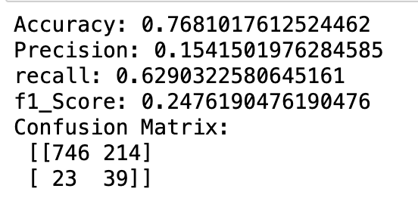
Output of Logistic Regression
High Recall
Low Precision and F1 Score
Implication Future.
This suggests that the Logistic Regression model is quite effective in identifying patients who are at risk of stroke. However, high recall alone might not always be desirable, especially if it comes at the cost of precision
This indicates a significant number of false positives, meaning the model often predicts a stroke risk when there isn’t one. In a medical context, this could lead to unnecessary anxiety and medical interventions.
While the model is good at detecting true positives, its tendency for false alarms might limit its practical applicability without further refinement.
.

Slide 13
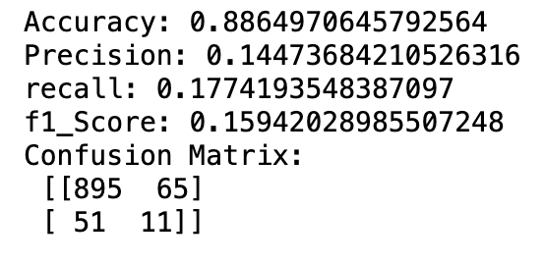
Output of Random forest
High Accuracy
High F1 Score
Implication Future.
(0.88 vs. 0.77)
This suggests that overall, the RandomForest model makes more correct predictions (both true positives and true negatives) than the Logistic Regression model
(0.24 vs. 0.12): This improved score indicates a better balance between recall and precision, making it a more reliable model in scenarios where both false positives and false negatives carry significant consequences.
Random Forest is potentially more suitable for practical use in a medical setting, given its balanced performance in correctly identifying stroke risks and avoiding false alarms..
.

Slide 14
Comparison
Five-Point Summary:
Accuracy: Random forest (0.8865) outperforms logistic regression (0.7681), indicating a higher overall correctness in predictions.
Precision: Logistic regression (0.1541) has slightly higher precision than random forest (0.1447), implying that when it predicts positive, it is more likely to be correct.
Recall: Logistic regression (0.6290) has higher recall compared to random forest (0.1774), suggesting that logistic regression is better at identifying positive instances.
F1-Score: Random forest (0.1594) has a lower F1-score than logistic regression (0.2476), which combines precision and recall into a single metric.
Confusion Matrix: Both models have different patterns in the confusion matrix, indicating varying strengths and weaknesses in classifying true positives, true negatives, false positives, and false negatives.

Slide 15
Summary
Logistic Regression Strengths:
Higher recall, suggesting better identification of positive instances.
Slightly higher precision.
Random Forest Strengths:
Higher accuracy, indicating better overall performance.
Although lower in recall, it may still perform better in scenarios where precision is crucial.
Considering the trade-offs between precision and recall, and the importance of accuracy, the choice between these models depends on the specific goals of the task. If precision and recall are equally important, logistic regression might be preferable. If overall accuracy is a priority, then random forest is a better fit.

Slide 16
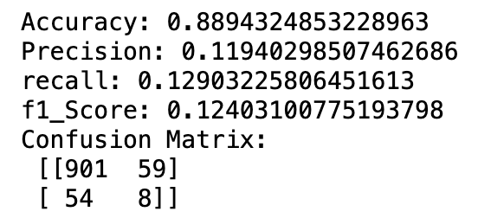
GridSearch
Before
After
Accuracy Improvement: The accuracy of the random forest model increased slightly after grid search, from 88.65% to 88.94%. While the improvement is not dramatic, any increase in accuracy is generally positive.
Confusion Matrix Changes: The confusion matrix provides insights into the model's performance. In both cases, there is a notable number of false positives (Type I errors), but the grid search resulted in a slight increase in false negatives (Type II errors), as evident from the changes in the matrix.

Slide 17


Conclusion
Significant Healthcare Cost Savings: The application has potential to save substantial healthcare costs by preventing strokes, including expenses related to hospitalization, medication, rehabilitation, and long-term care.
Indirect Economic Impact: Preventing strokes contributes to a healthier, more productive workforce, positively impacting economic productivity.
Quantifiable Savings through Prevention: The application's impact can be quantified by estimating the savings from preventing a certain number of strokes. This involves considering the average cost of stroke treatment per patient and multiplying it by the number of prevented strokes.
Balancing Risks and Benefits: A crucial aspect is the need for a thorough risk-benefit analysis. While false positives may incur costs in terms of unnecessary medical interventions, they need to be weighed against the potential costs and impacts of false negatives, which could result in failing to identify a true stroke risk.
Costs of False Positives: It is essential to consider the costs associated with false positives, including unnecessary medical tests, treatments, and the psychological stress on patients incorrectly identified as at high risk.
Efficiency Gains through Automation: The application can lead to significant reductions in labor costs by automating stroke prediction, streamlining the risk assessment process, and enabling faster decision-making.

Slide 18

Thank You

